Slide 1
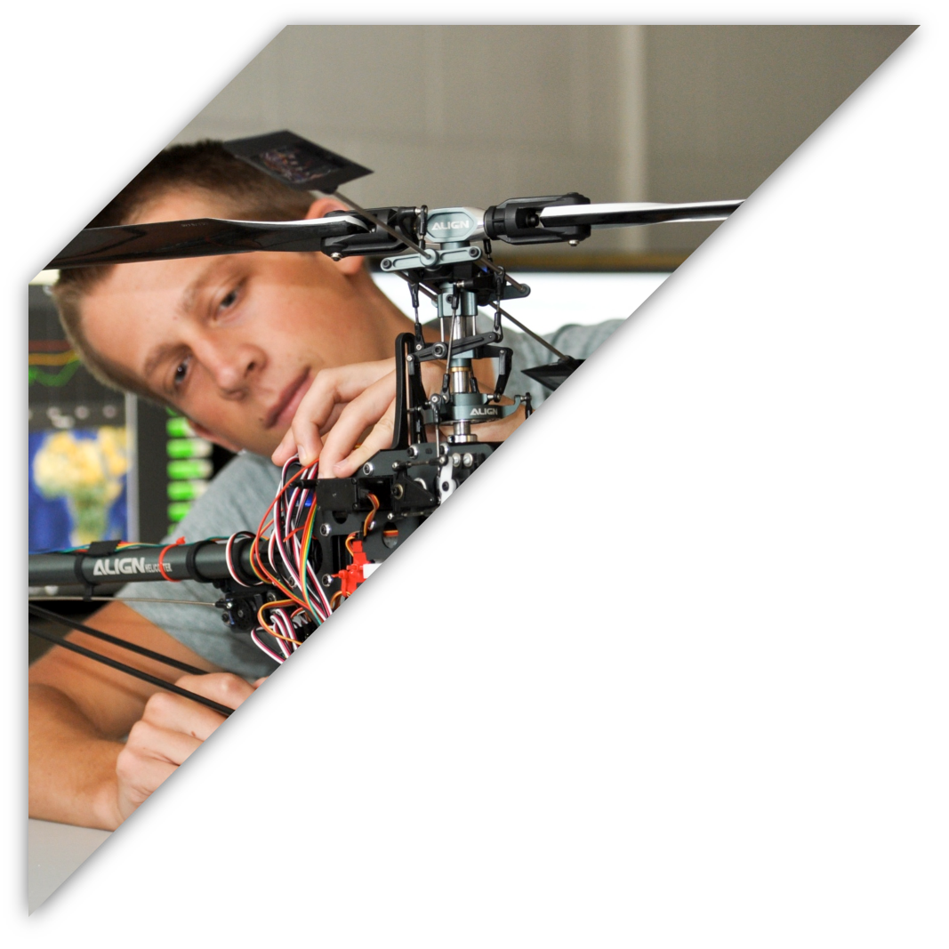

ECEN 403
GAN Assisted Map Reconstruction for first responders using Sensor Fusion:
Christian Jeardoe, Quinn LeBoeuf
Kyle Smejkal, Rufus Tadpatri

Slide 2

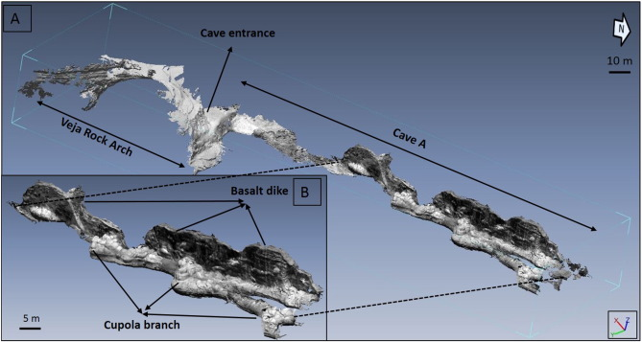
Problem Statement
Emergency situations often require first responders to delve into dangerous environments with minimal information.
Fires, gas leaks, cave rescues, and radioactivity are examples of hazards in various environments

Slide 3
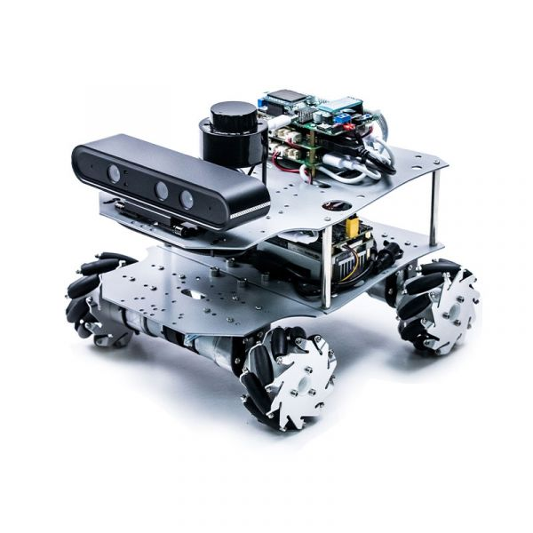
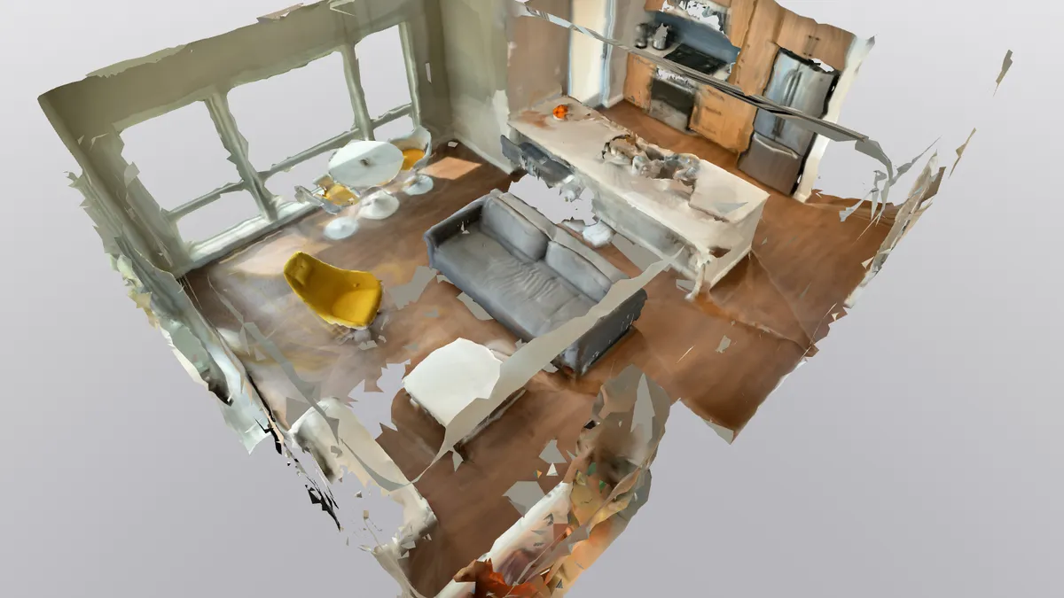
Solution Proposal
Create a multi sensor, GAN assisted, map reconstruction program that can be utilized on a mobile platform to create a virtual 3D twin of any environment.

Slide 4
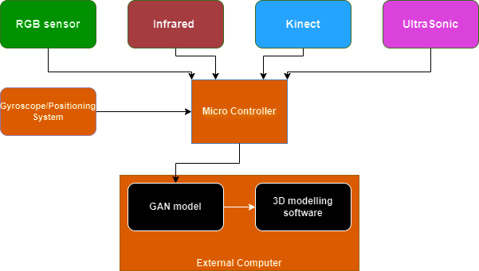
Diagram of Subsystems and Interface

Slide 5
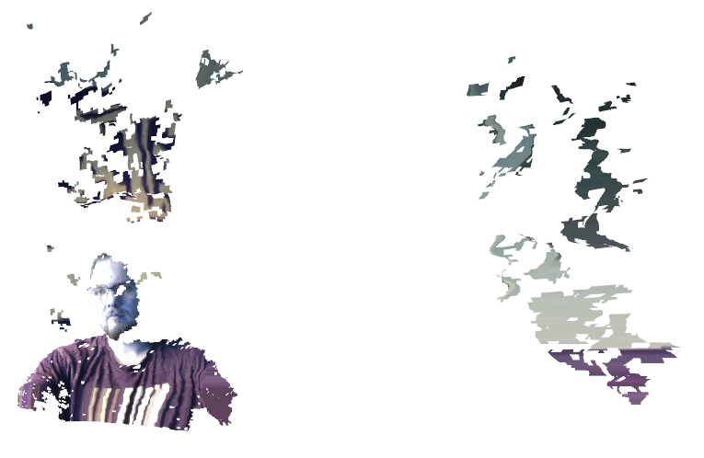
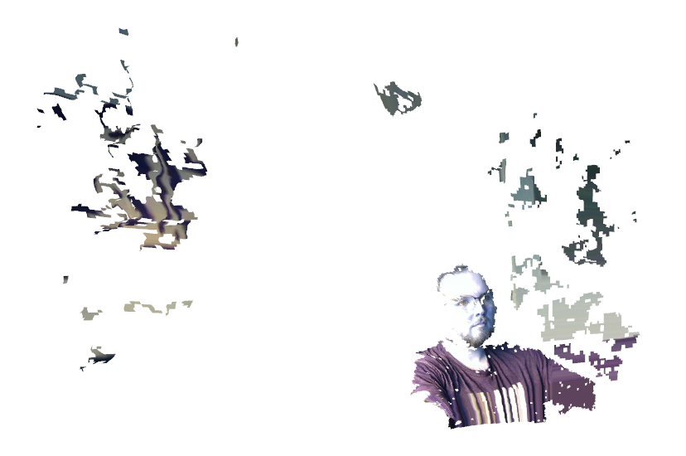
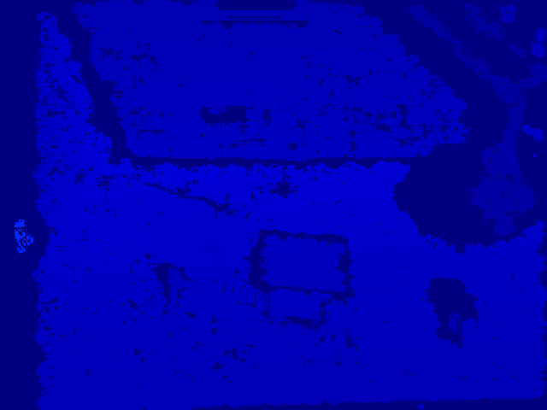
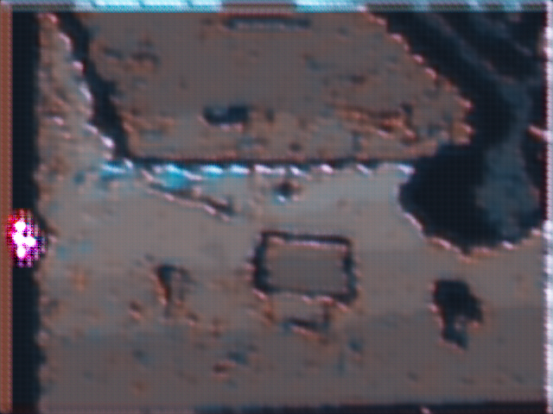
RealSense (RGB/IR)
Christian Jeardoe
Accomplishments since the last presentation | Ongoing progress/problems and plans until the next presentation
Installed required SDK and setup environment <27 hrs> 3D Point Cloud Generator <4 hrs> GAN model <7 hrs> | Recollecting good training data after switching from kinect sensor Continue tuning GAN model/Point Cloud Generator
3D Point Cloud Example
RGB Image Generated using Depth Map

Slide 6
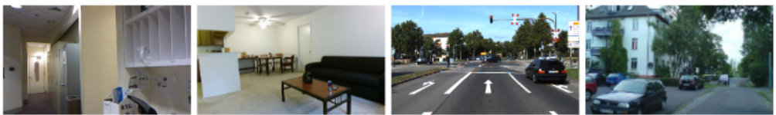
-RGB Sensor-
Rufus Tadpatri
Accomplishments since the last presentation | Ongoing progress/problems and plans until the next presentation
Environment setup <14 hrs> GAN model development <12 hrs> Sample dataset testing <4 hrs> | Additional testing with sample dataset Need to get point cloud using sample dataset Realtime RGB inputs into point cloud

Slide 7
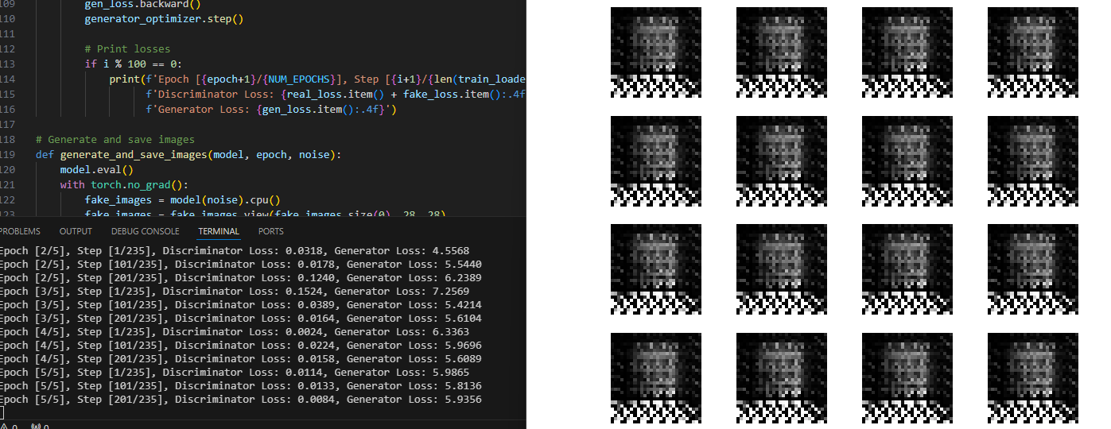
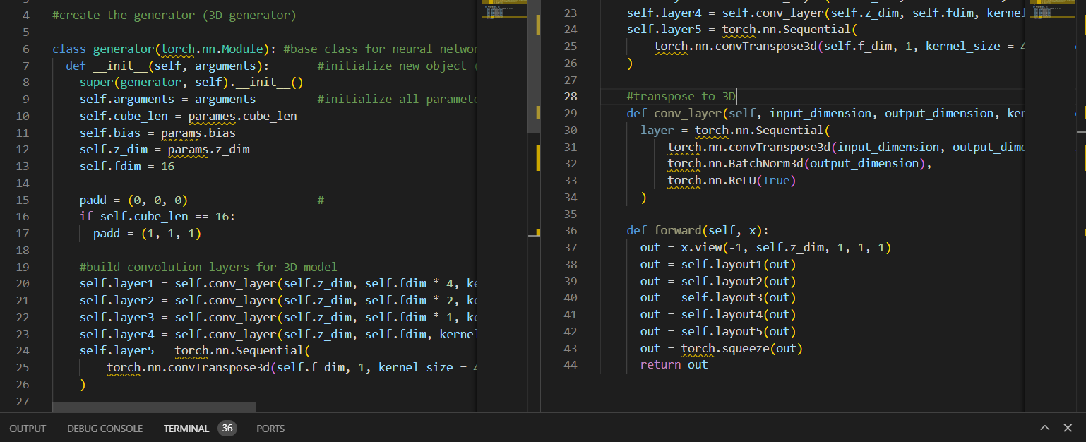
-Ultrasonic Sensor-
Quinn LeBoeuf
Accomplishments since the last presentation | Ongoing progress/problems and plans until the next presentation
Python Environment, ML libraries, & intro project <15 hrs> Ultrasonic Sensor & controller setup <7> Sample GAN model & 3D model development <15 hrs> | Depth image generation from ultrasonic sensor data and rgb camera GAN model point cloud generation from data Concurrent point generation with data retrieval
Sample GAN (image to image translation)
3D generator development code

Slide 8
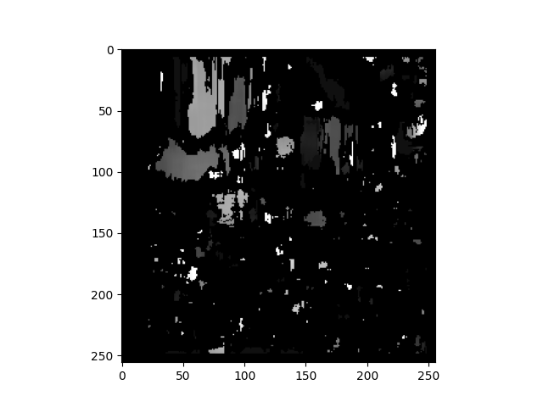
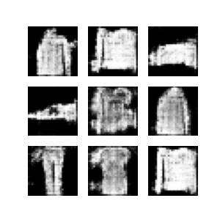
-Infrared Sensor-
Kyle Smejkal
Accomplishments since the last presentation | Ongoing progress/problems and plans until the next presentation
Python environment setup <11 hrs> GAN model development <12 hrs> Sample GAN dataset testing <6 hrs> | Connect RGB/Infrared sensor and create dataset Improve depth map and point cloud generation
Depth map example
GAN model output

Slide 9
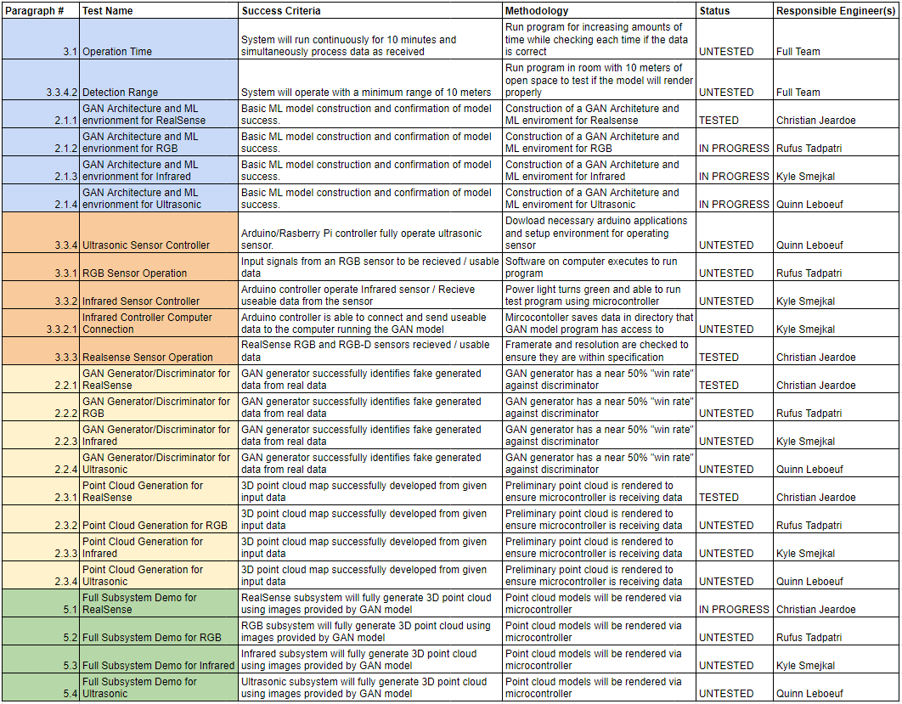
Validation Plan

Slide 10
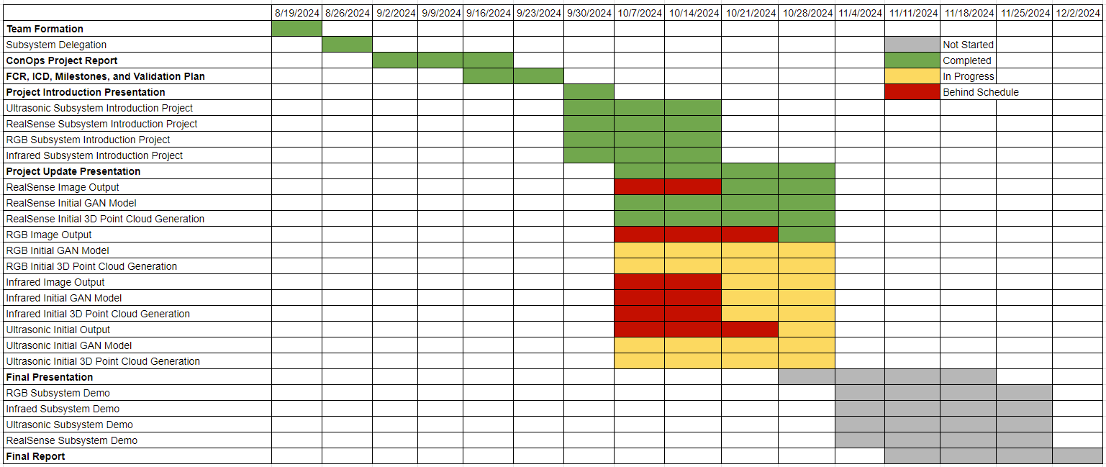
Execution Timeline

Slide 11
Thank you

